Slide 1

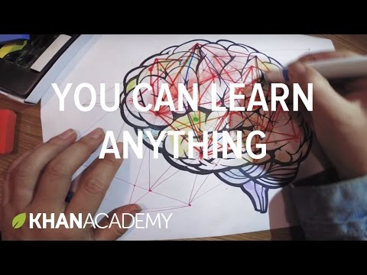
0:05 Nobody's born smart
1:08 Because the most beautiful, complex concepts in the whole universe are built on basic ideas
1:13 that anyone can learn, anywhere can understand. Whoever you are, whereever you are
1:18 You only have to know one thing: You can learn anything
Notes:
Lets start

Slide 2
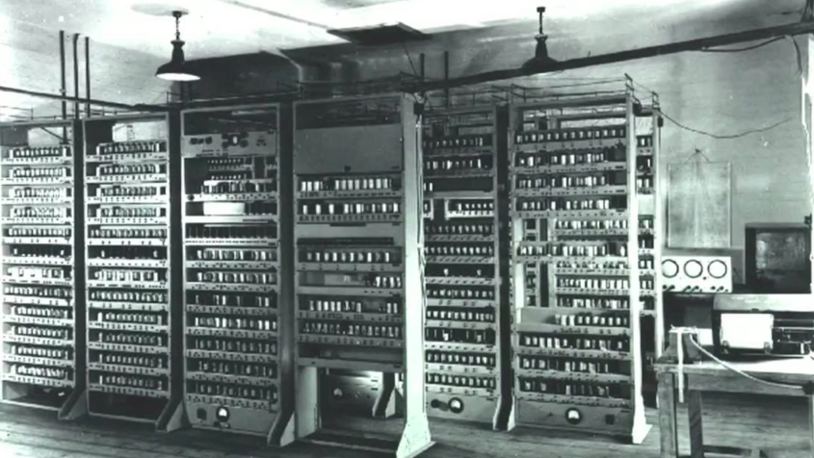
Notes:
1952 - Tic Tac Toe # Picture Above. First Human vs Computer race started.
1997 - Deep Blue - Chess ==> Exploring Solution Space
2011 - Watson - Jeopardy ==> Constructive Reasoning
2017 - Alpha Go - Go - [Possibilities > total no. atoms in this universe] ==> Developing Intuition

Slide 3
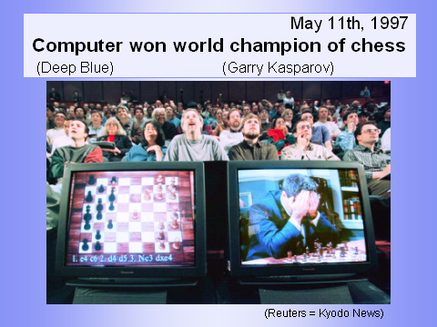
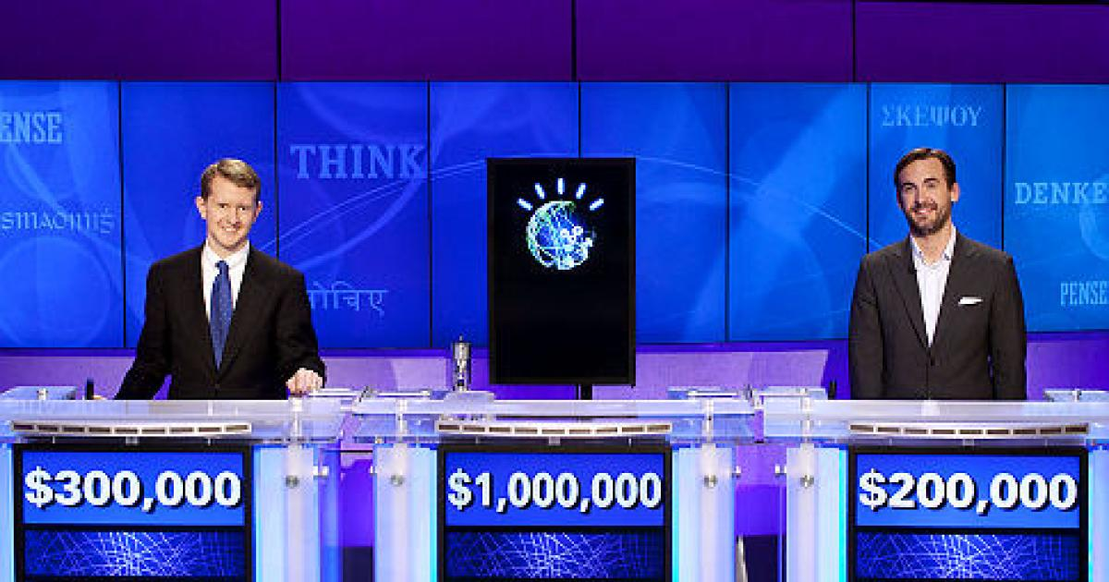
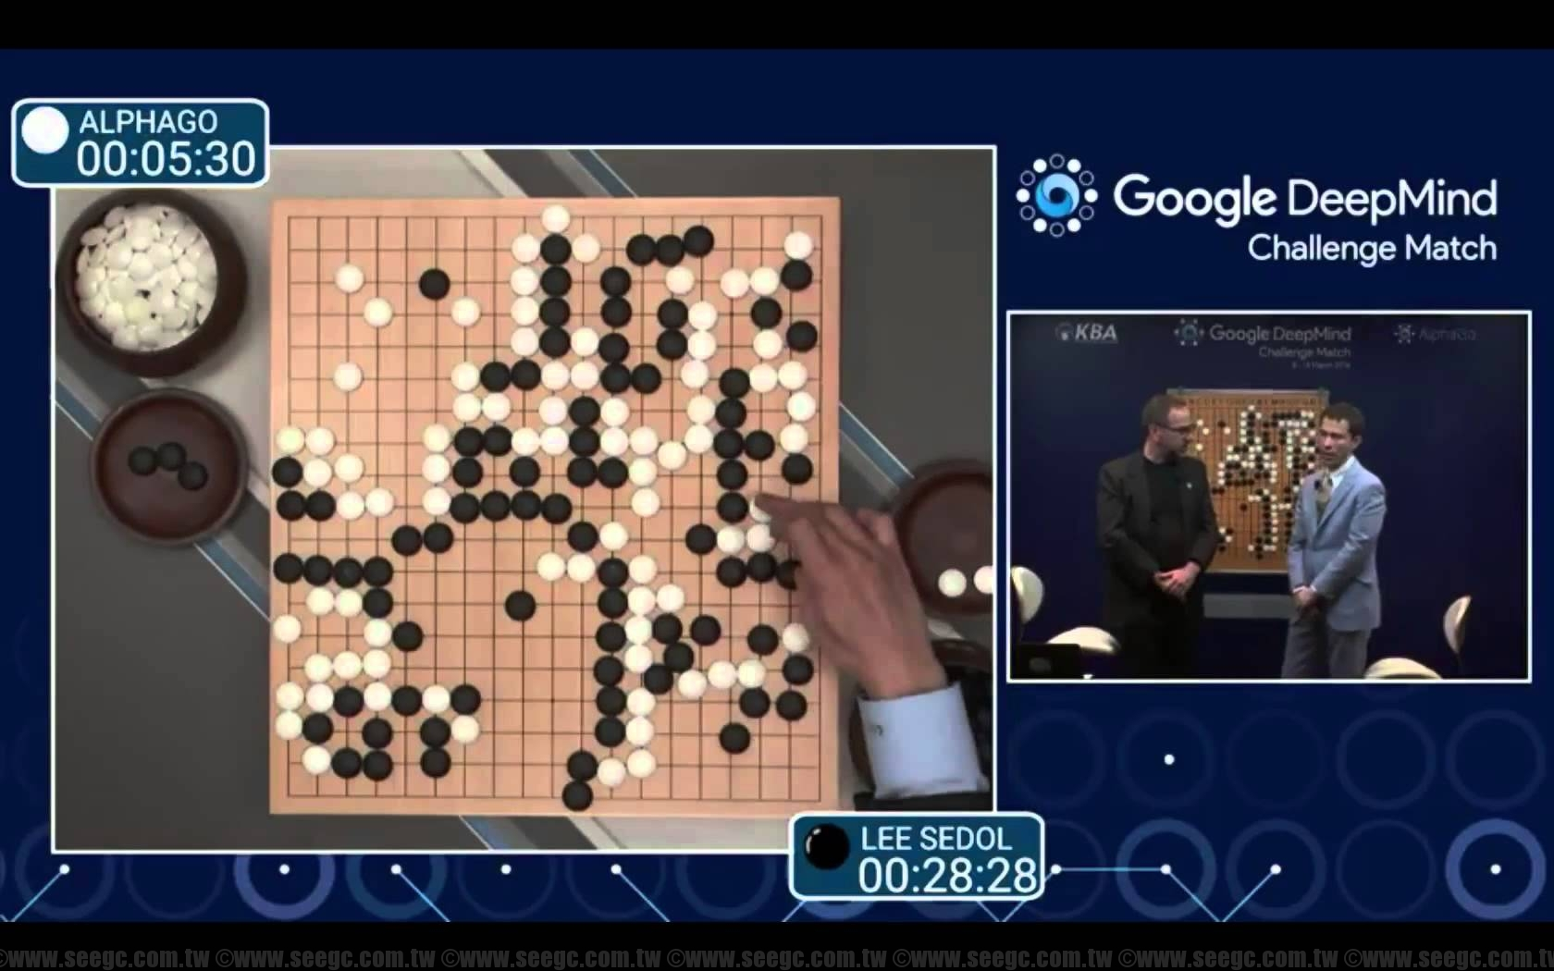
2011 Watson - Jeopardy
Data Science
1952 - Tic Tac Toe ⇒ Human vs Computer
1997 - Deep Blue - Chess ⇒ Exploring Solution Space
2011 - Watson - Jeopardy ⇒ Constructive Reasoning
2017 - AlphaGo - Go ⇒ Developing Intuition
In AlphaGo, no. of possibilities > total no. atoms in this universe.
Notes:
1952 - Tic Tac Toe
1997 - Deep Blue - Chess ==> Exploring Solution Space
2011 - Watson - Jeopardy ==> Constructive Reasoning
2017 - Alpha Go - Go - [Possibilities > total no. atoms in this universe] ==> Developing Intuition

Slide 4
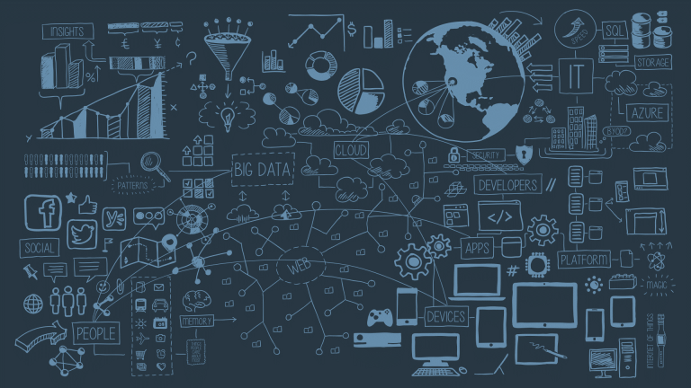
Introduction to Data Science
June, 2017

Slide 5

About Me
Eduction
2012 Pass out, M.Sc. Information system - Bits, Pilani Rajasthan.
Trained in RHEL 6, AIX, Business Communications
Certified Data Modelling Engineer.
Software Engineer
4.5 Years in Data Engineering & Data Analytic.
1 Year in Data Sciences and Data Modelling.
Python, Oracle DB, Oracle Apex.
Personal Life
Teaching(blog), Music, Anime, lazy.
Health Conscious, Gym/Yoga/lots of Sleep.
Technology & Personal communication skills.
Motivation:
Bridge the gap between Technology and People. Lead a R&D Team.
Notes:
Big Data - Blue whale.

Slide 6

Plan
Introduction
Definitions [ Data Science ]
What, Why and How
Examples
Data Science - In Action
Stages [DG, DC, DM, ME]
Regression & Clustering Models
Basics [ LR, GD ]
Real Life Application
Examples
Data Science Tools
Examples
Suggestions
Tips

Slide 7
What is Data Science?
Notes:
AQ - System Admins/Developers/ QA/ HR/
AQ - How many of you heard of Data Science? Can you explain me, what is data science to you?

Slide 8
What is Data Science?
da•ta
Factual information, especially information organized for analysis or used to reason or make decisions.
Computer Science Numerical or other information represented in a form suitable for processing by computer.
Values derived from scientific experiments.
sci·ence (sī′əns)
The observation, identification, description, experimental investigation, and theoretical explanation of phenomena. Ex. New advances in science and technology.
Such activities restricted to a class of natural phenomena. Ex. The science of astronomy.
A systematic method or body of knowledge in a given area. Ex. The science of marketing.
Archaic Knowledge, especially that gained through experience.
Notes:
Learn to draw - Newton’s observation of Apple falling from a Tree. Trojan Horse. Galileo - Watching ships moving, Kepler’s Law - Planetary System. Edision - bulb.

Slide 9
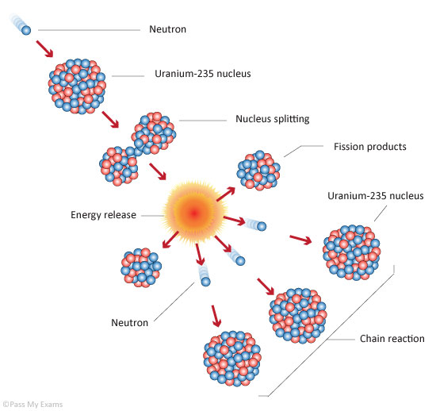
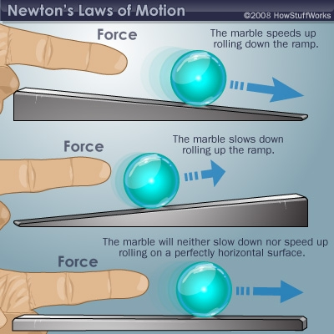
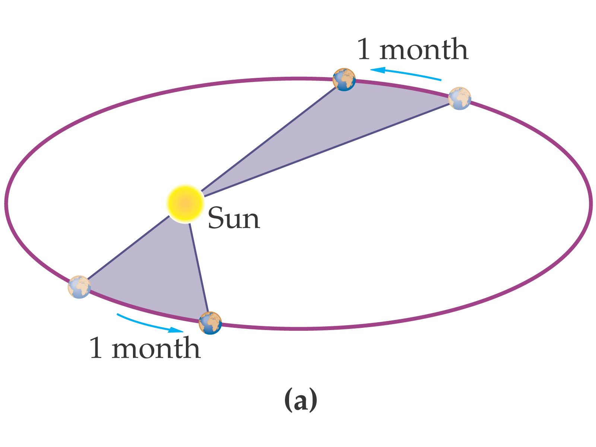
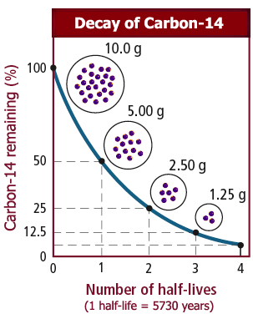
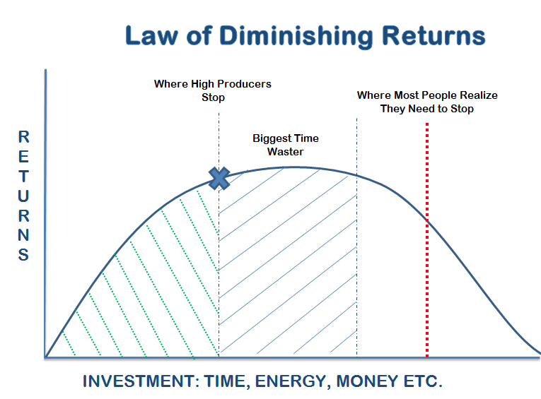
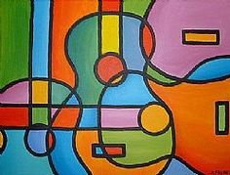
Data Science Examples
Notes:
> Newton’s Laws of Motions
> Laws of Diminishing Returns
> Kepler’s Laws of Planetary Motions
> U-235 Chain Reaction
> Arts - Music, Painting, Linguistics,..

Slide 10
Why Data Science?

Slide 11
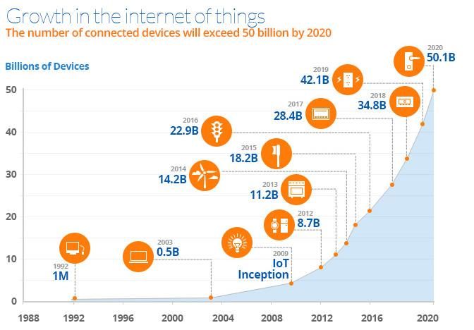
Growing Devices
Technological Advancements
Cheaper Storage
Faster Computations
IOT
RAD Tools
Bigger Questions?
Notes:
Usual Method: Data ⇒ Analysis ⇒ Rules/ Principles.
Data ⇒ Principles/Laws/Observation ⇒ Evaluation Experiments ⇒ Real Life Applications.
# Landing on Moon # Talking to a person at the other End of the world # Flying to other end of worlds

Slide 12
Information Explosion & Doubling Processing Power
Metcalfe's law states that the value of a telecommunications network is proportional to the square of the number of connected users of the system (n2).
Moore's law is the observation that the number of transistors in a dense integrated circuit doubles approximately every two years.
(Population - Thanks to Advanced Medical Sciences & Improving Health Care.)
Sources: Wikipedia
Notes:
Basic Fundamental

Slide 13
How to do Data Science?

Slide 14
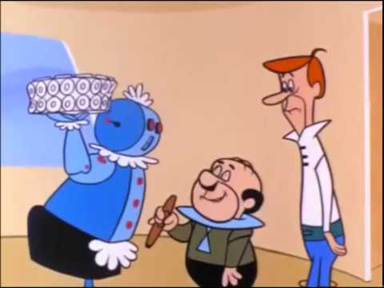
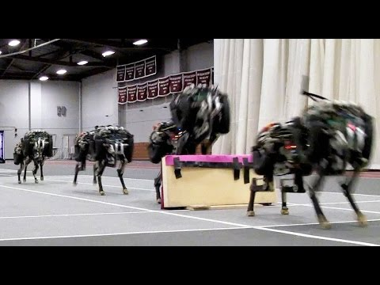
How to Data Science? - AI, ML
Rosey, Spacely, Jetson
MIT Cheetah Robot
Notes:
Artificial Intelligence. Actual Goal of - simulate a human being.
1 understand 2 (action) interact 3 expressive # they know table manners
Like a child, first achievement is talking first step.
1 understand situations 2 acting(judge height/speed/time)

Slide 15
How to do Data Science
You can use lots of sophisticated analytical & Business Intelligent tools and come to a simple understandable explanations.
(or)
You can also use, simple tools like calculators or excel sheet to generate simple and simple results.

Slide 16
Plan
Introduction
Definitions [ Data Science ]
What, Why and How
Examples
Data Science - In Action
Stages [DG, DC, DM, ME]
Regression & Clustering Models
Basics [ LR, GD ]
Real Life Application
Examples
Data Science Tools
Examples
Suggestions
Tips

Slide 17
Data Science - In Action
Battles behind the scenes

Slide 18
Stages of Data Science
Purpose
Relevant Data Collection
Wrangling(cleansing)*
Data Analytics
Feature Engg.*
Data Modelling*
Data Prediction*
Evaluation*
(*) ⇒ Repetitive stages
Reportings
Finalising Report
Data Product Building (software development)
Architecture
Development
Testing
Deployment
Notes:
Wrangling - Structuring Data. Preparations -> Numbers.

Slide 19
Data Model
Random Forest Model
Bagging
SVM
Linear Equation

Slide 20
Iris Dataset - Goal
<< Ipython Notebook >>

Slide 21
Plan
Introduction
Definitions [ Data Science ]
What, Why and How
Examples
Data Science - In Action
Stages [DG, DC, DM, ME]
Regression & Clustering Models
Basics [ LR, GD ]
Real Life Application
Examples
Data Science Tools
Examples
Suggestions
Tips

Slide 22
Data Science - Real Life App
Few applications that inspired me
Notes:
Experience is the best mentor.

Slide 23
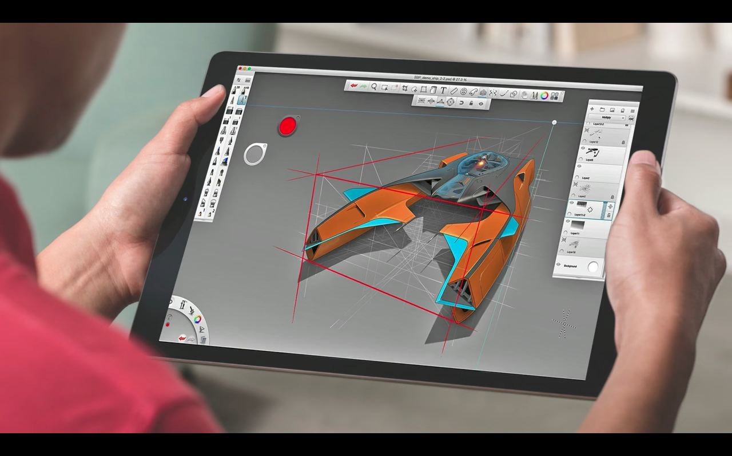
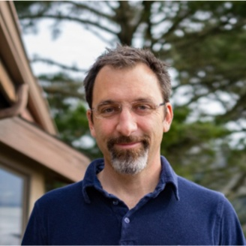
Passive Designs + AI
Maurice Cont
Director of Applied Research & Innovation
Autodesk, San Francisco Bay Area.
TED Talk: The incredible inventions of intuitive AI
Notes:
Passive Designs > Generative > Intuitive

Slide 24
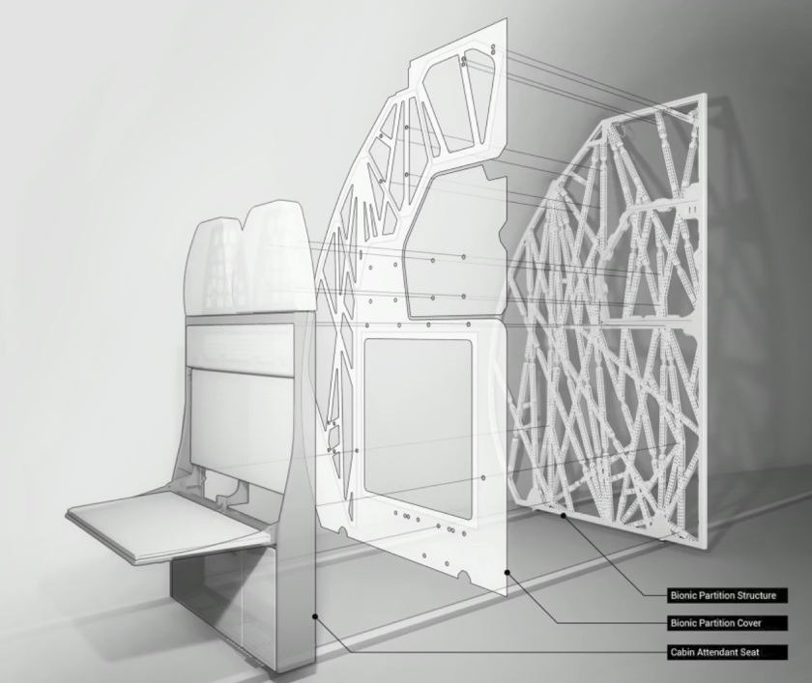
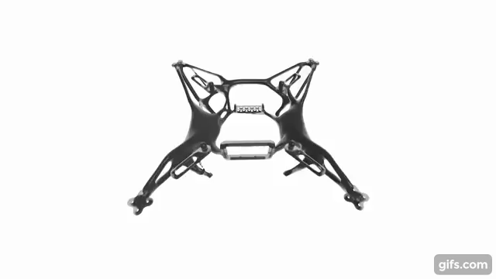
Generative Designs > Passive Designs
AI Designed Lightweight Cabin Partition
Airbus - A320
AI Designed Lightweight Drone Chassis
Notes:
Director of Applied Research & Innovation, Autodesk
3D Printed AI Design - Cabin Partition for Airbus - A320
Cars - Manufactured to Farmed
Buildings - Constructions to Growns
Cities - Isolated to Connected

Slide 25
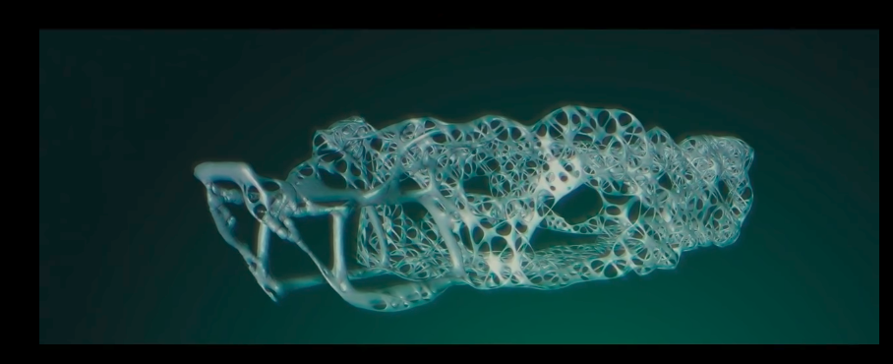
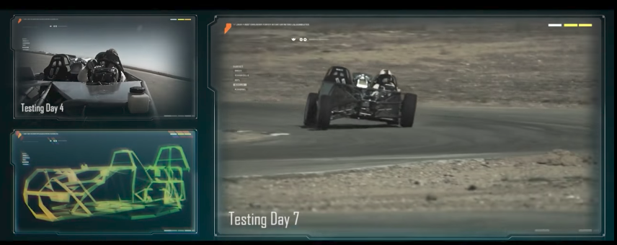
Generative Designs
Notes:
Traditions Race Car Chassis - Gave Nervous System - 4 Billions Data Points

Slide 26
Generative Designs
AI Designed Car Chassis
Notes:
4 Billions Data Points

Slide 27

Music XRay
Jimmy Lloyd Songwriter Showcase
Popular songs share Melody & Rhythm
Genere - 70
Cluster 60
Singer & Song Writer NY
http://www.heidimerrill.com/epk/index.html
Notes:
AI - Predicting if a Song will be HIT
Songs - Optimal Mathematical Patterns
25 Million Views

Slide 28

Pred Pole
2011 Santa Cruz Pred Pole
Crime, Location & Date-Time
https://www.predpol.com/
Results:
50% Crime Rate control
20% reduction in Crime Rate
Notes:
#### Minority Report is a 2002 American Sci-Fi
#### Director:Steven Spielberg
#### Starring:Tom Cruise, Colin Farrell, Samantha Morton, Max von Sydow

Slide 29
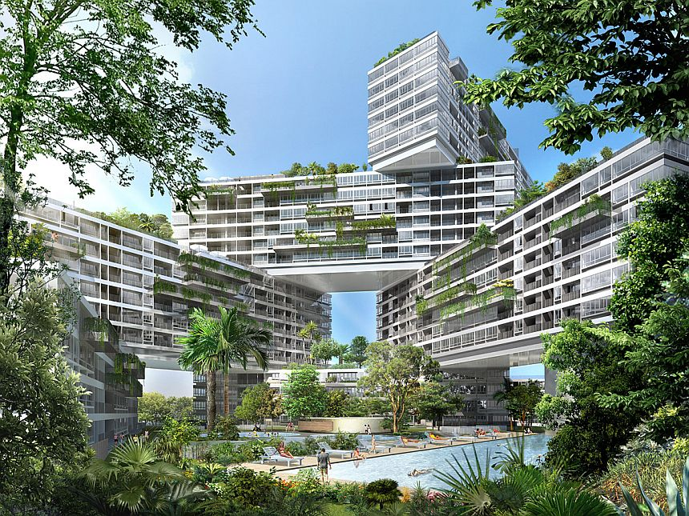
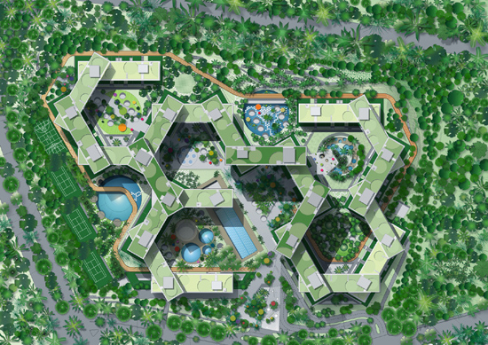
Generative Designs
Project - Interlace
Notes:
Project Interlace - Singapore
DayLights Problems + Energy Consumption + Water Bodies(micro Climates)

Slide 30
Plan
Introduction
Definitions [ Data Science ]
What, Why and How
Examples
Data Science - In Action
Stages [DG, DC, DM, ME]
Regression & Clustering Models
Basics [ LR, GD ]
Real Life Application
Examples
Data Science Tools
Examples
Suggestions
Tips

Slide 31
Data Science - Tools
Too many to name, but none of them are close perfection.
Notes:
Experience is the best mentor.

Slide 32
Data Science Tools
Languages: Scala, R, Python, Java, C#
Lib: Scikit, DeepNet, Tensor flow, Theano, H20
Frameworks: Apache Spark
These are some used by used us (Imaginea Labs - Data Sciences - 4th Floor, Hyd).
Notes:
Open Sourced Tools used us, if you are planning to use these - you can take some help.

Slide 33
Suggestions
Challenges in DS & Tips to who want to start.

Slide 34
Suggestions?
Data Preparation
“Give me six hours to chop down a tree and I will spend the first four sharpening the axe”. Abraham Lincoln
Python, Scala, Excel, Databases(regex).
Data Analytics
“Seeing is believing”
Python(Matplotlib, Seaborn), D3.Js, Excel.
Data Models
“There are no perfect solutions, but some work better”
Learn 2-3 types of Clustering, Regression Models(LR,RF,SVM,KNN,XGB)
Evaluation
“A product not tested is broken by default”
Accuracy, RMSE, Precision-Recall, F1 Score
Notes:
Add pyramid Model.

Slide 35
Questions?
Sampath - Desk 4F 072. Imaginea Labs - Data Sciences.
Sachin, Keerat, Bipul, Kavi, Mageshwaran.

Slide 36

Thank you
Notes:
Big Data - Blue whale.

